Slide 1
Cpt. Allen and Crew 11 C
Fire Station 11
Serving Salt Lake City
and
Pacific Heritage Academy

Slide 2
Salt Lake City Fire: The Capital City Fire Department
350 employees
14 Fire Stations
3 trucks 12 engines 2 quints 4 ARFF 3 light medical
3 CHAT
ISO Class 1
HazMat Heavy Rescue Swift Water ARFF
Notes:
3 MRT, 3 CHAT, 2 Reserve Trucks, 4 Reserve Engines, 3 Training Engines, 1 Command Vehicle, 2 HazMat, 1 Type III Wildland Engine, 6 Type VI Wildland Engines, 3 Type VI Reserve Wildland Engines, 3 Polaris Side by Sides/ Per Cpt Sharp, July 2023

Slide 3
Salt Lake City Fire has 14 Fire Stations in SLC

Slide 4
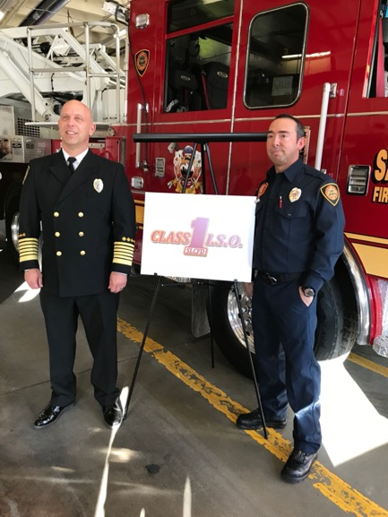
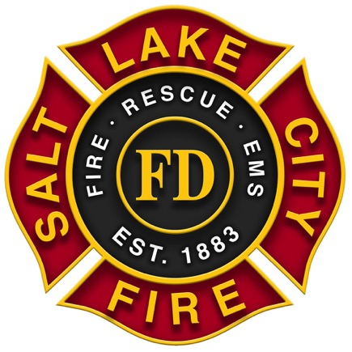
Notes:
Highest standard of care based on ISO rating.

Slide 5
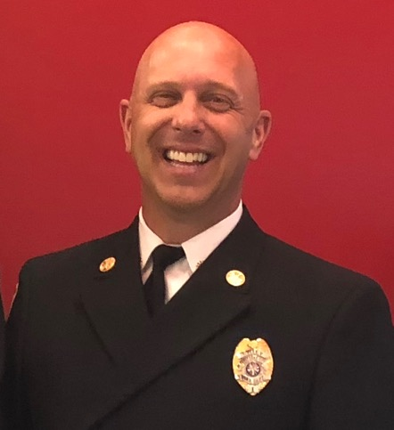
Chief Karl Lieb
SLC Fire Chief: 2017-Present
SLC Fire Deputy Chief
SLC Fire B.C.
SLC Fire Captain
1995 SLC Firefighter w/ HazMat specialty
Montana State Highway Patrol
U.S. Air Force
B.S. of Psychology
Masters of Public Administration

Slide 6
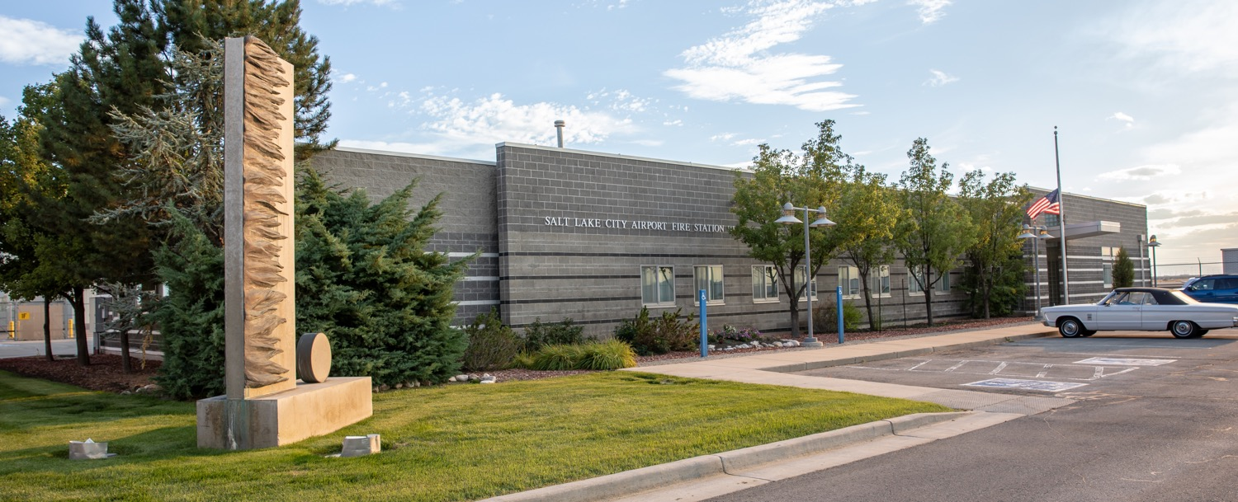
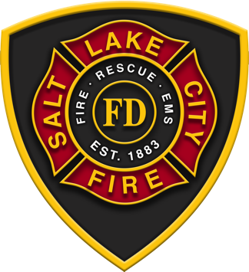
Fire Station 11 serves the area of Salt Lake City that includes the airport and your school, Pacific Heritage Academy.
There are 3 platoons that serve every day of the year.
Cpt. Allen and crew are platoon C.

Slide 7
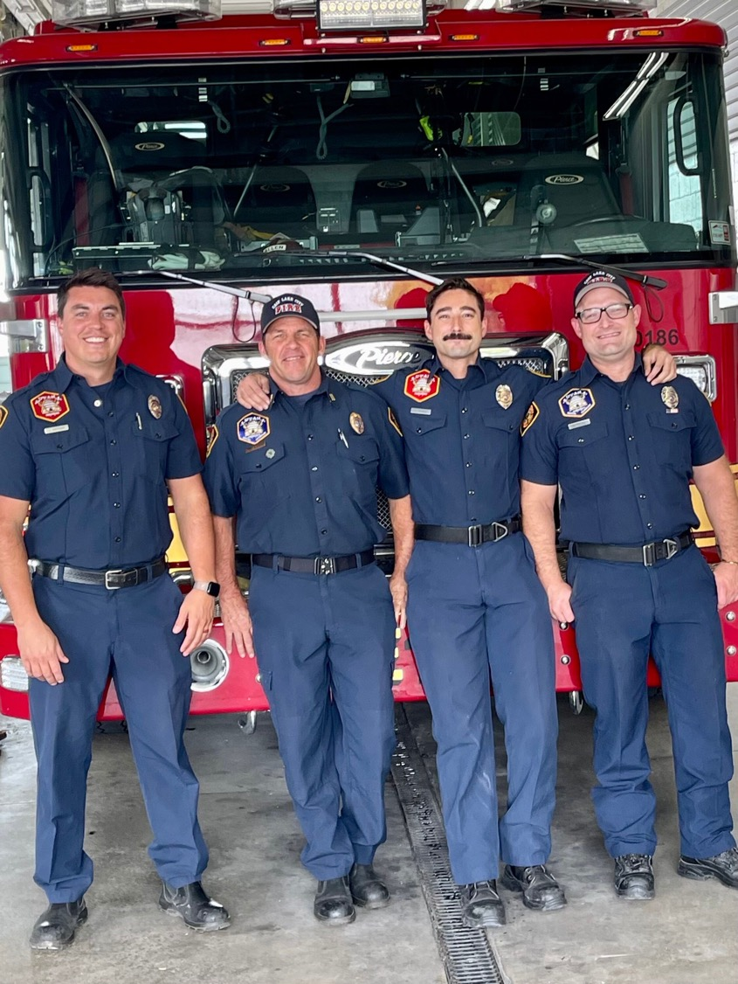
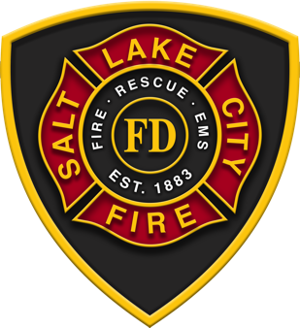
Captain Allen and the crew of 11C serve your school and area. They will be your educational partners this year in our One School, One Crew program.
Notes:
Crew can introduce themselves at this time.

Slide 8
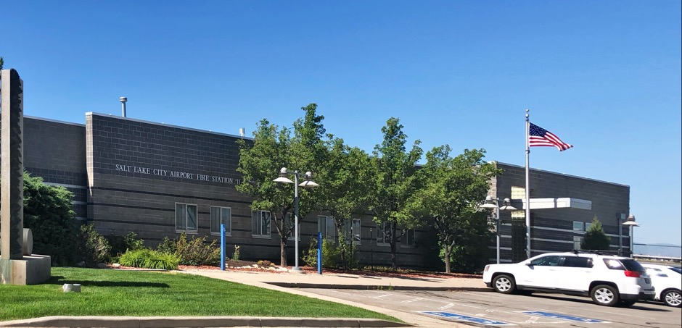
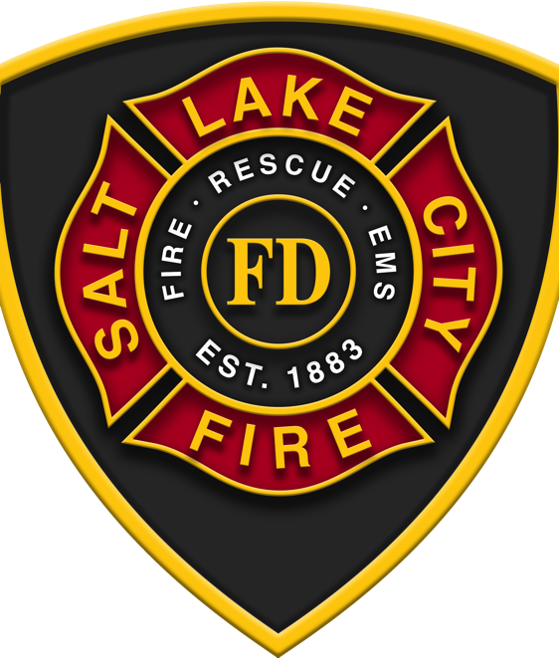
Firefighters live at the Fire Station for 48 hours while serving their set.
Let’s look at what’s inside the fire house.

Slide 9
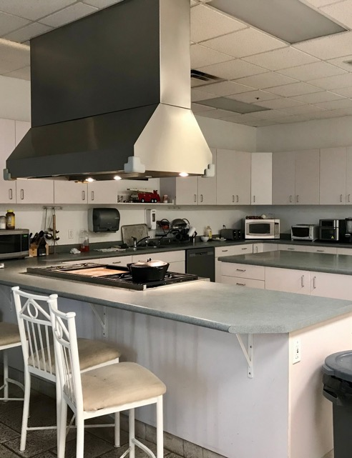
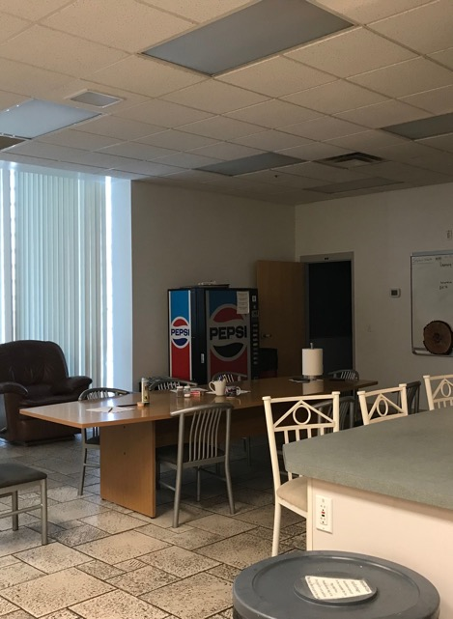
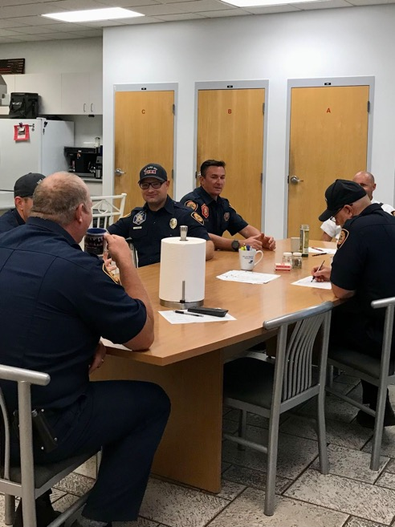
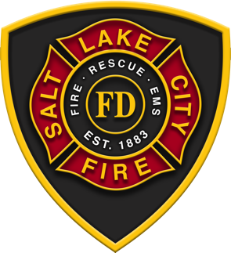
The kitchen is the heart of the station.
The crew gather here to eat, visit, and do paperwork.

Slide 10
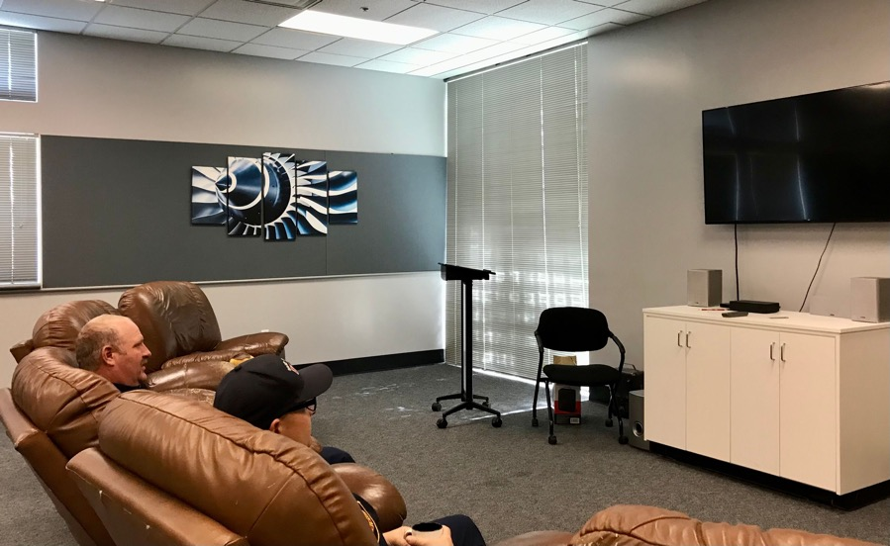
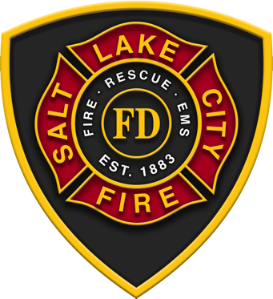
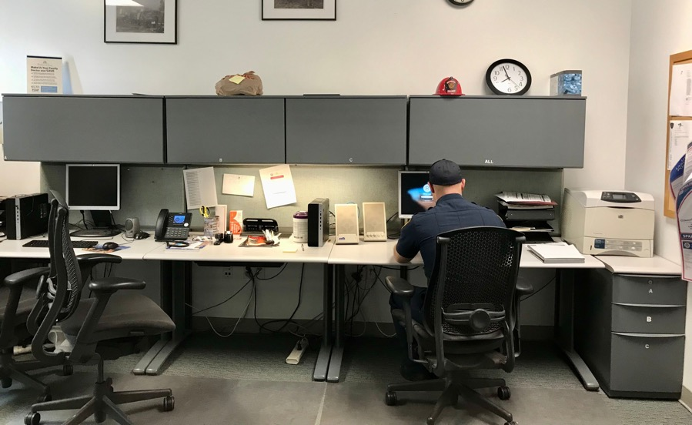
In the station too we see a training room and office. The crew will sometimes relax in the training room or get some rest after a long night.

Slide 11
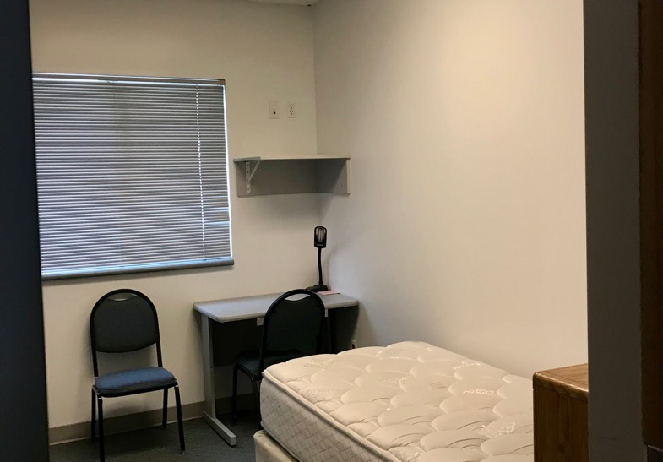
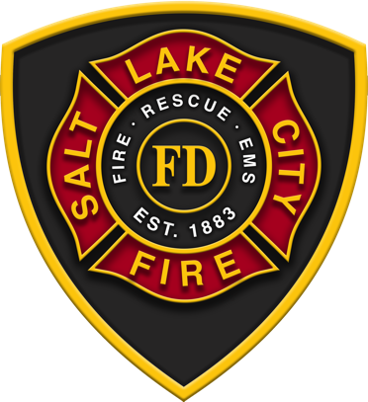
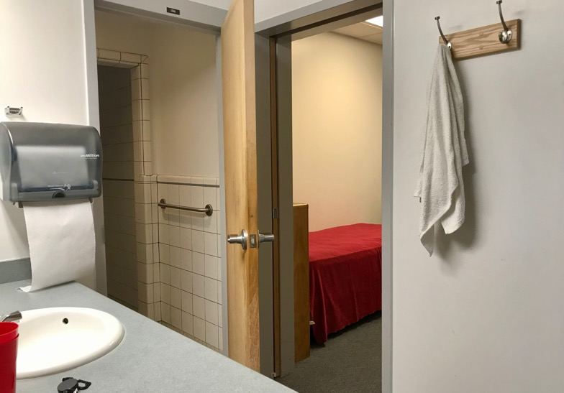
Firefighters have their own rooms at the station.
Each room has a shared bathroom.

Slide 12
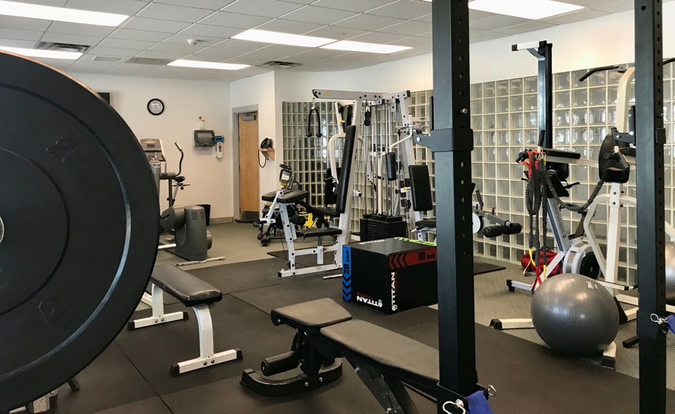
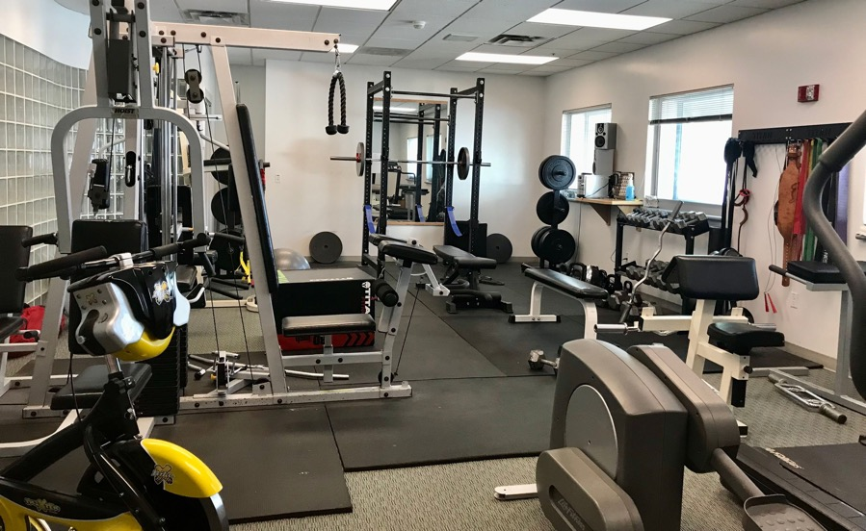
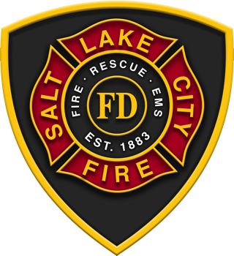
It’s important that firefighters stay fit for their job.
Each fire station has a gym, and the firefighters work out daily to stay in shape.
Fit to serve is the motto.

Slide 13
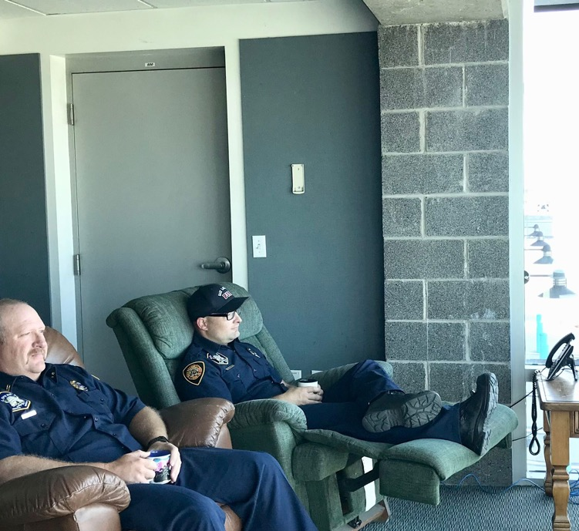
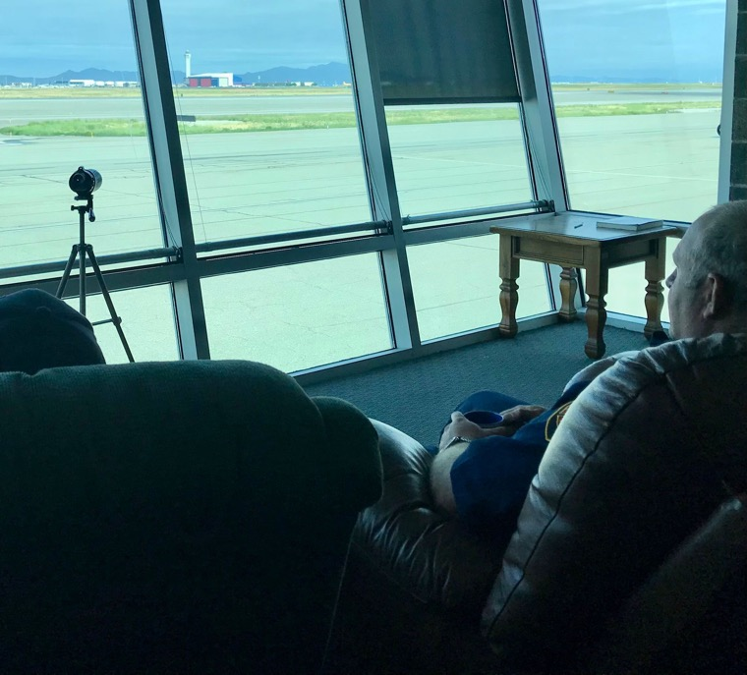
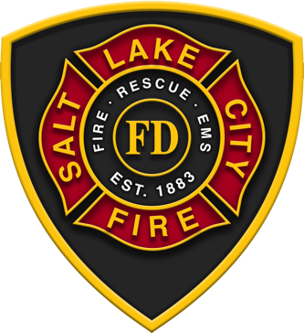
Another area in the fire station is the observation room that overlooks the tarmac.

Slide 14
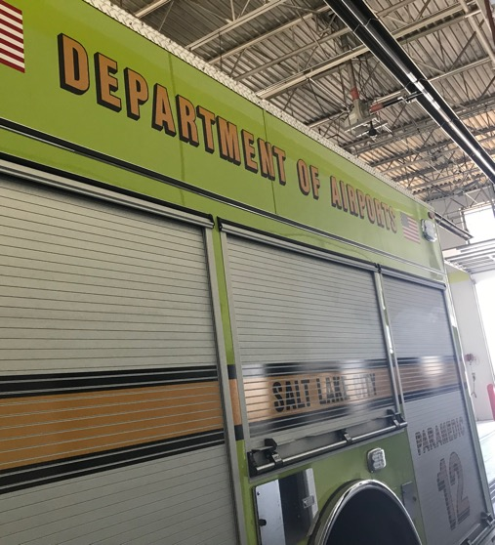
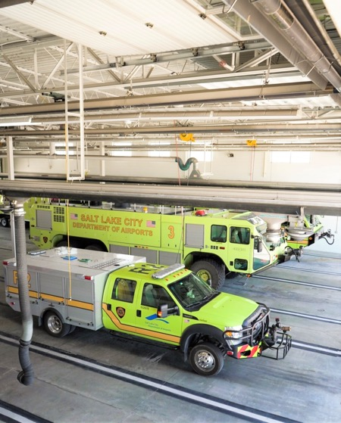
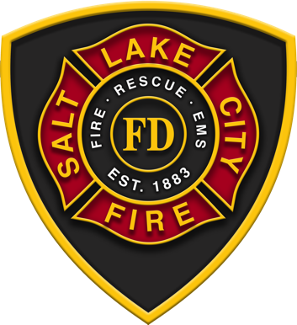
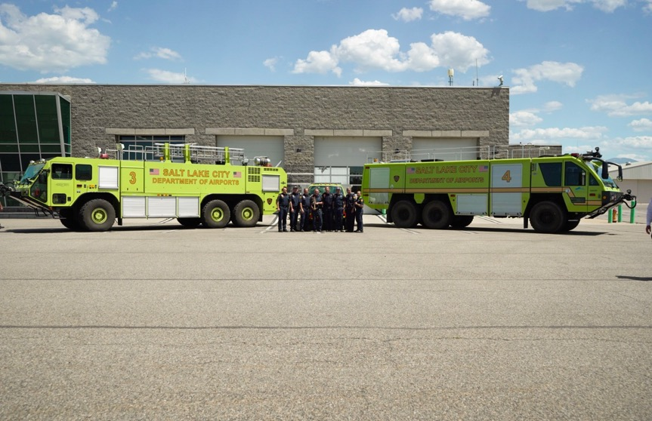
Here we see the bay and back side of the fire house.
Fire Station 11 serves the airport as well as the city, so they have ARFF apparatus.
These rigs are a different color and have special features for needs at the airport.

Slide 15
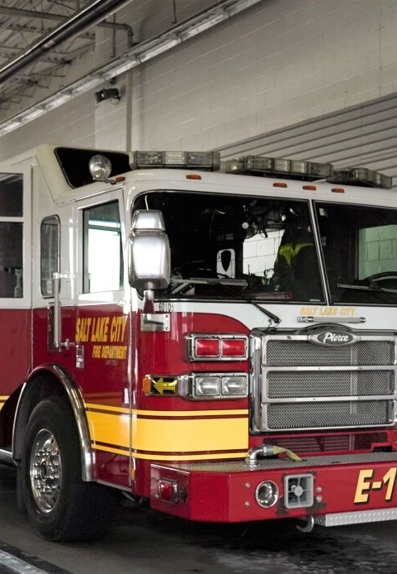
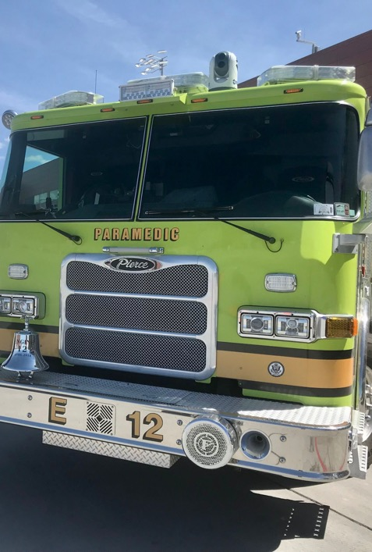
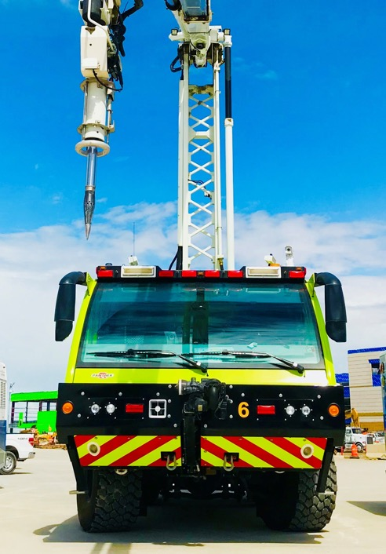
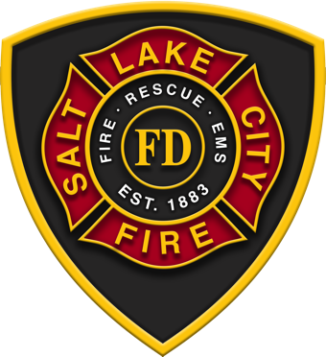
Salt Lake City Fire was established in 1883 and has been serving at the airport for 75 years.

Slide 16
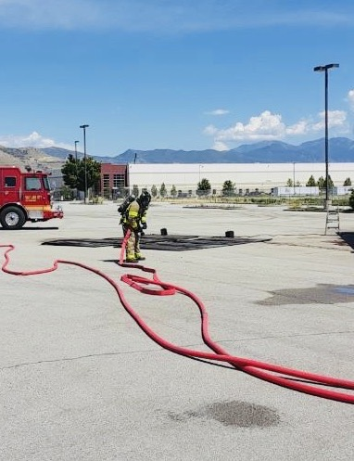
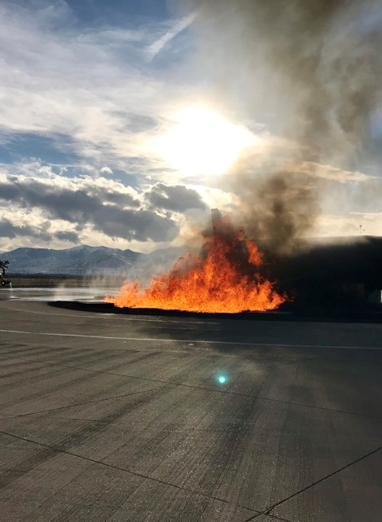
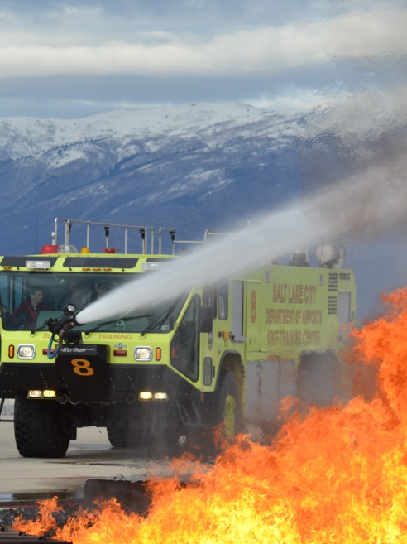
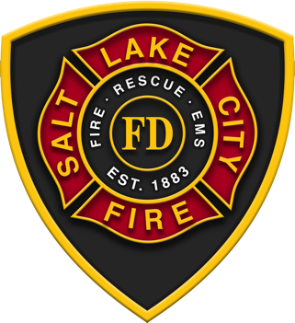
Salt Lake City Firefighters serve by putting out fires and in other ways too.

Slide 17
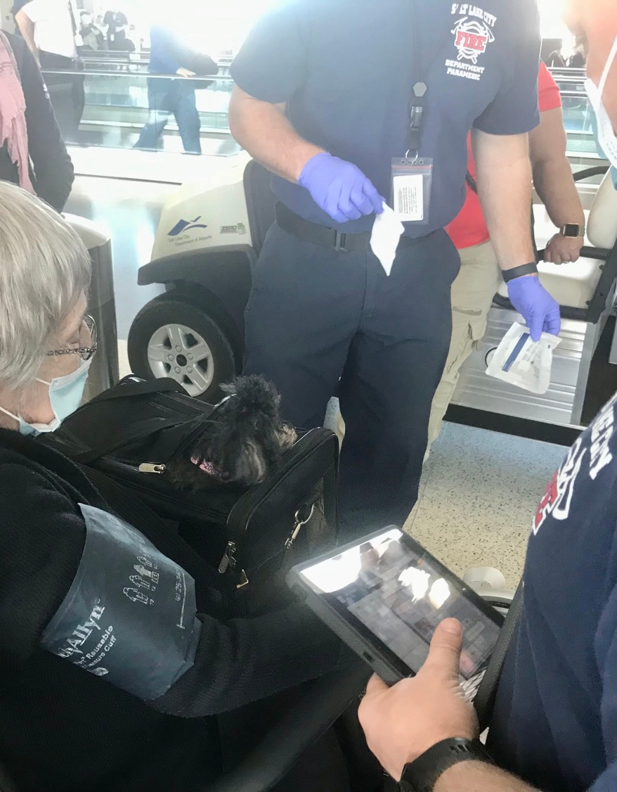
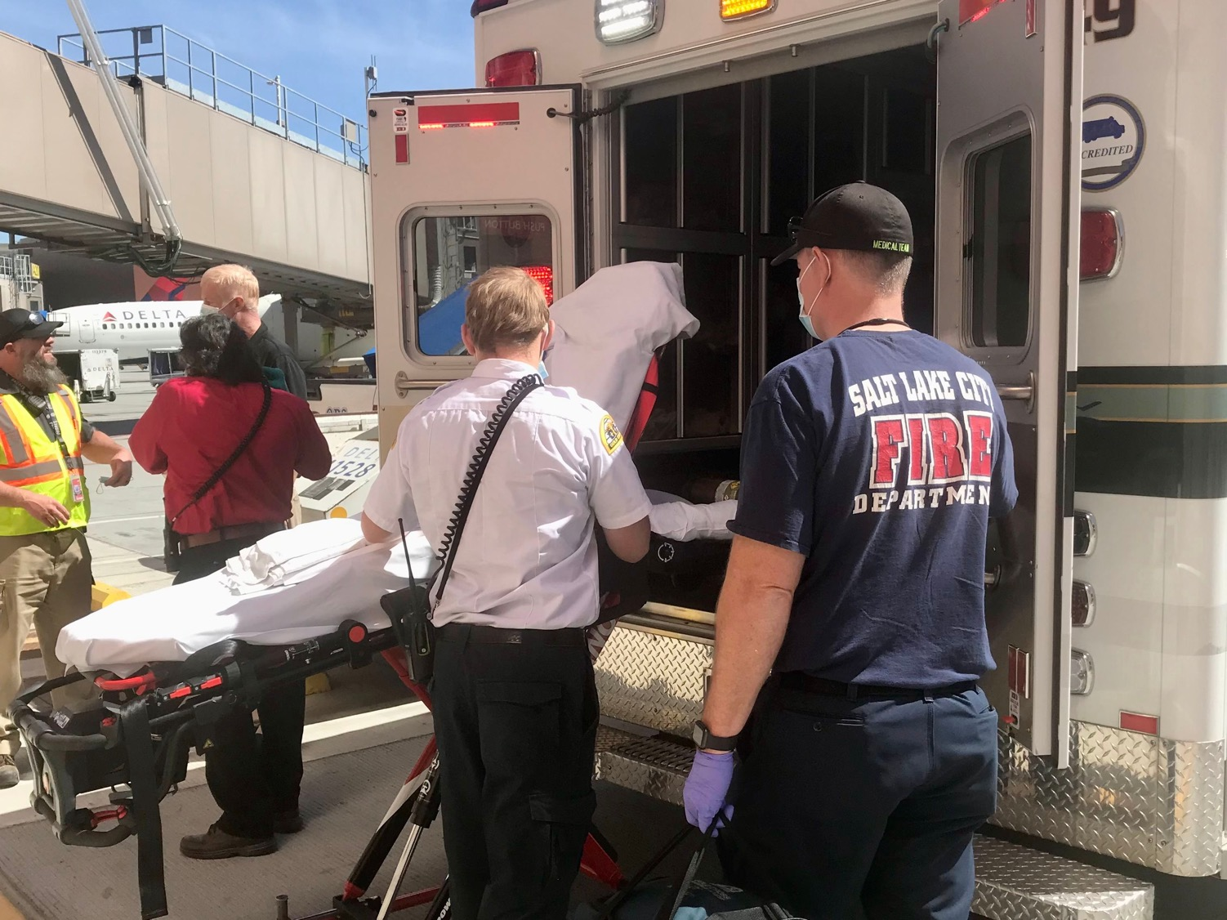
Salt Lake City Firefighters assist in medical emergencies.

Slide 18
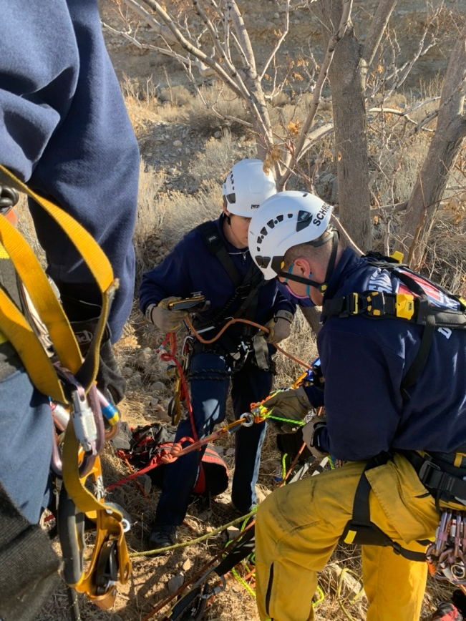
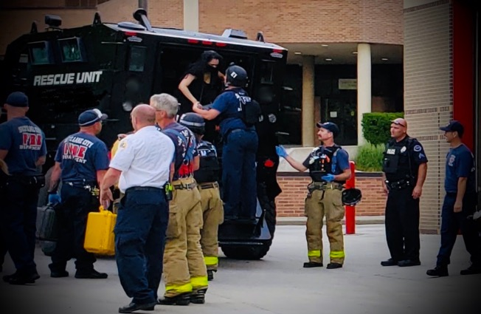
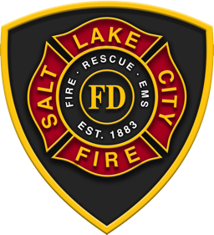
Firefighters help rescue people in need.

Slide 19
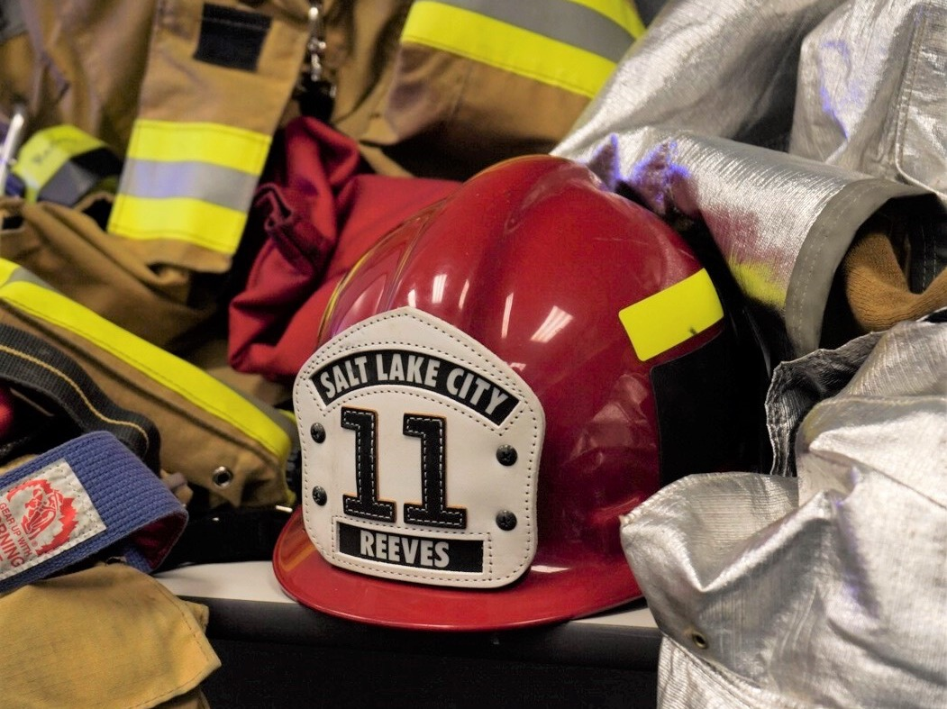
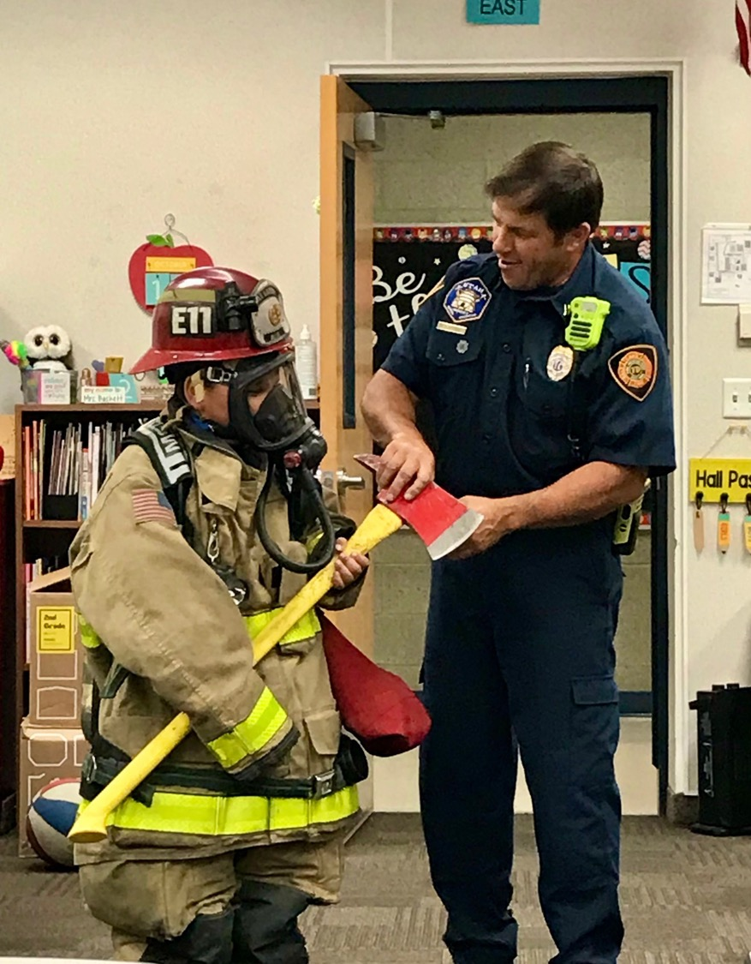
Salt Lake City Firefighters educate as part of their community service as well.

Slide 20
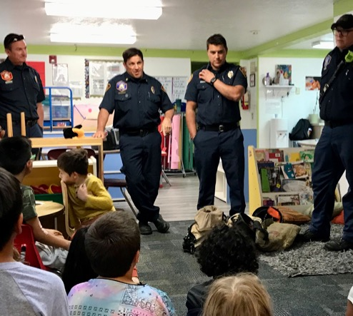
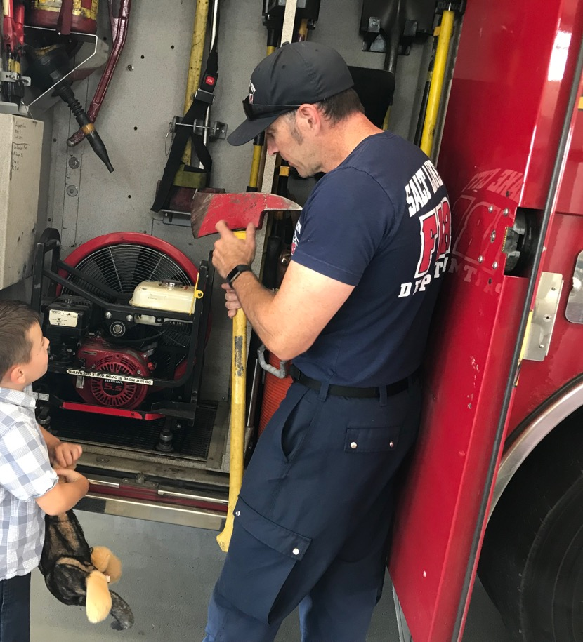
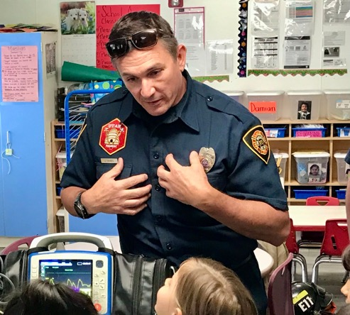
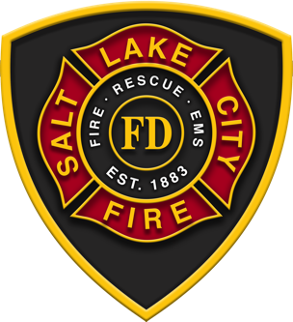
Teaching others helps them prevent fires and be safe.

Slide 21
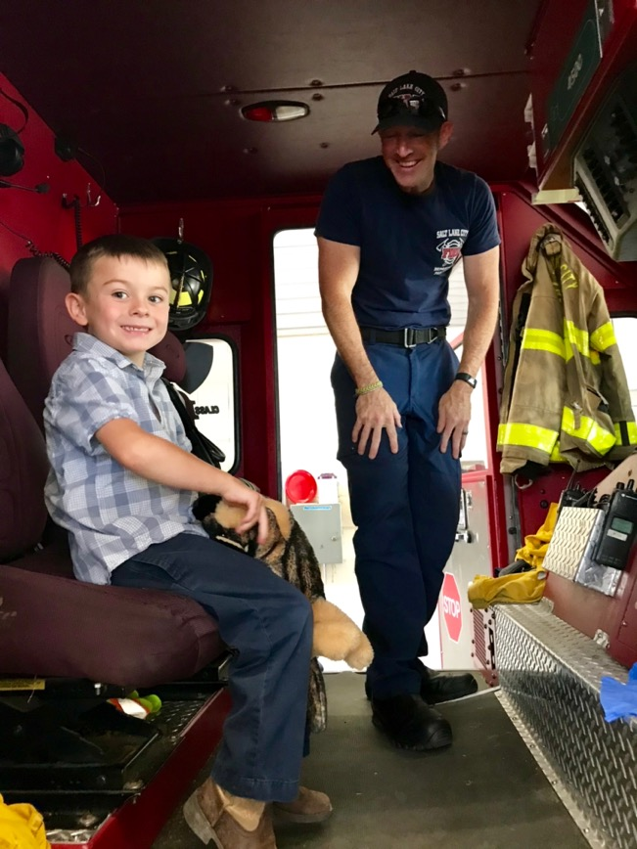
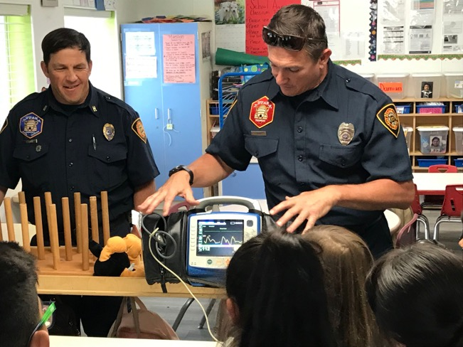
Salt Lake City firefighters go to schools to teach, and students come to the fire station to learn.

Slide 22
Notes:
Helping others with fire, medical and educational services is all part of the Salt Lake City Firefighters job.

Slide 23
Salt Lake City Fire looks forward to working with Pacific Heritage Academy this year!!

Slide 24
Want to learn more about firefighting? Go online: www.slcfire.com/futures

Slide 25
Invite SLC Firefighters to your class.
Schedule a fire station tour.
https://www.slc.gov/fire/contact/

