Slide 1
SLC Fire Station 3 B Platoon
SLC Fire Station 3 with
Cpt Kauffmann and Crew.

Slide 2
350 Employees
14 Fire Stations
3 Trucks 12 Engines 2 Quints 4 ARFF 3 Light medical
3 CHAT
ISO Class 1
HazMat Heavy Rescue Swift Water ARFF

Slide 3
SLC Fire keeps Salt Lake City safe.

Slide 4
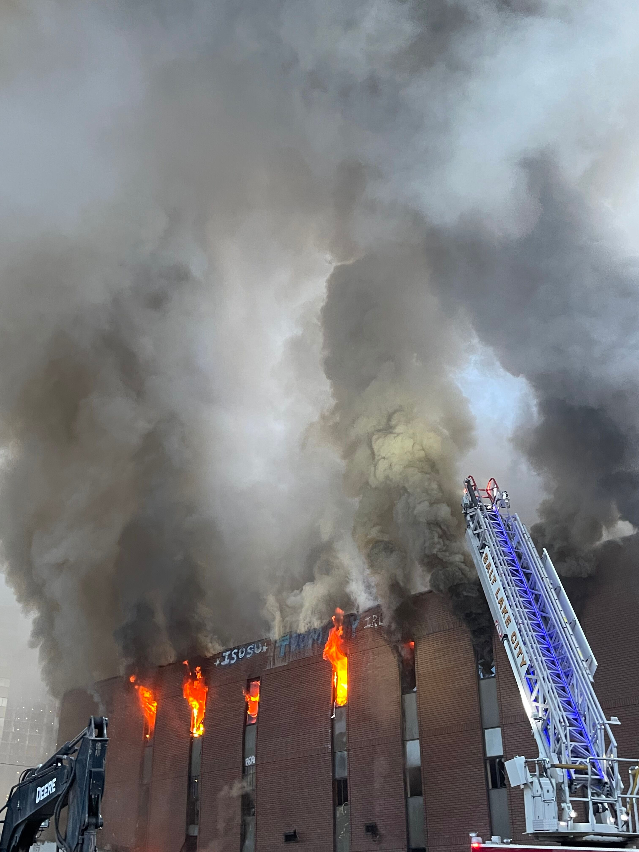
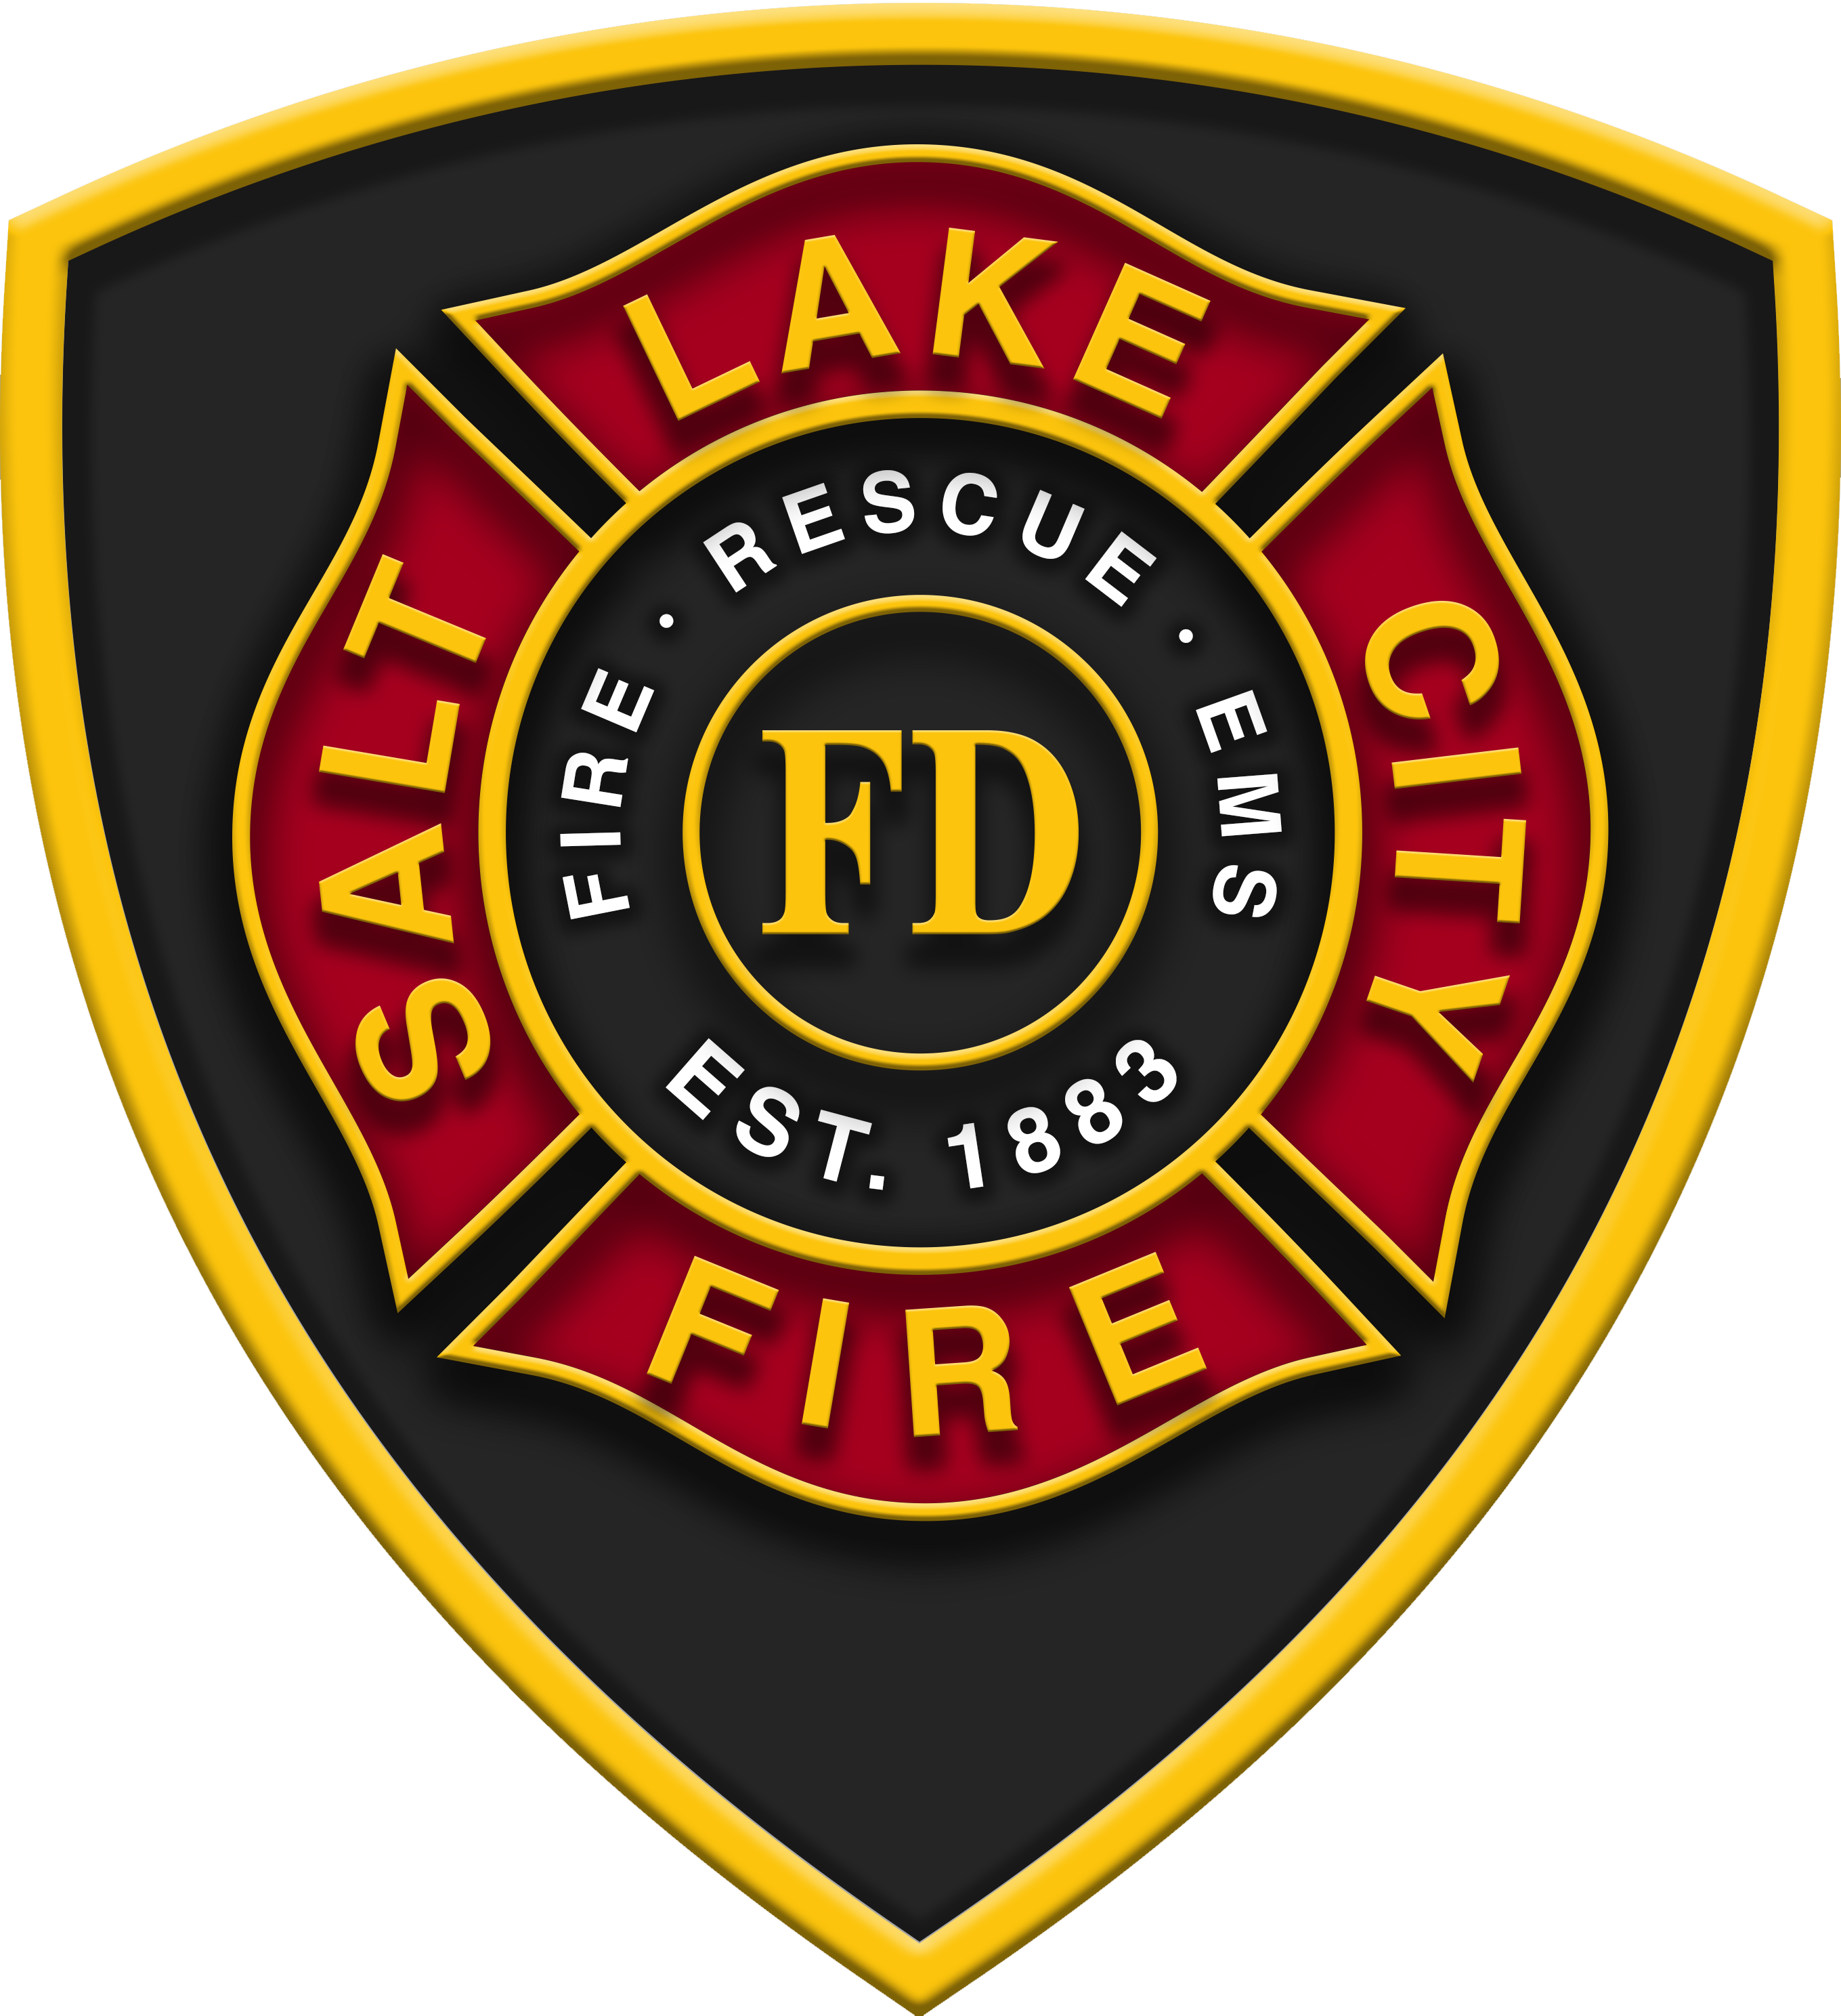
SLC Fire keeps the city safe during fires,

Slide 5
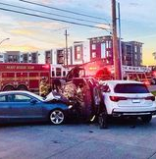
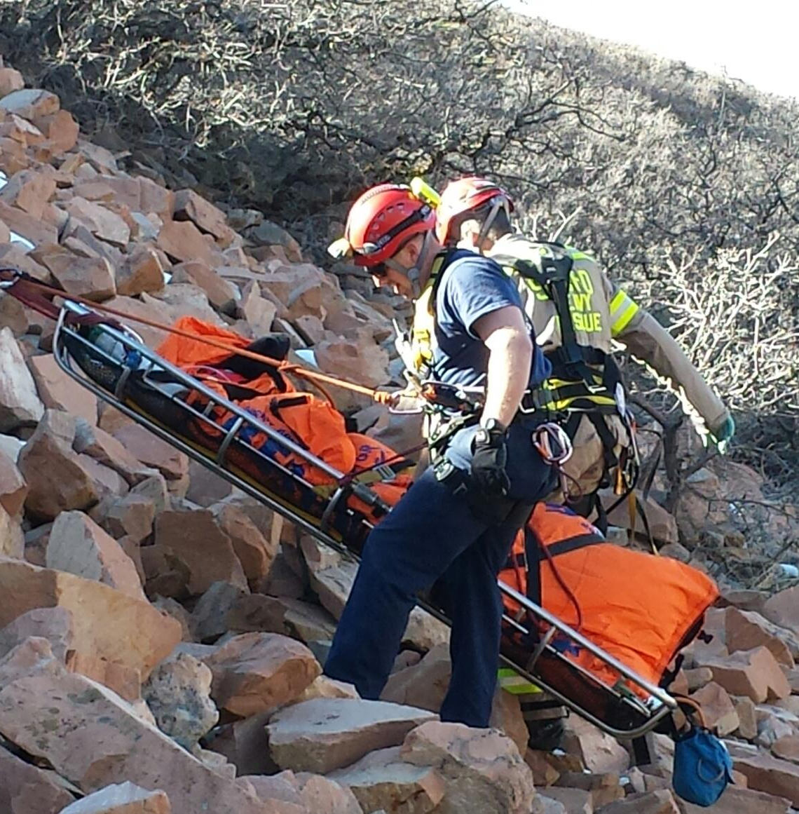
and when people get hurt.

Slide 6
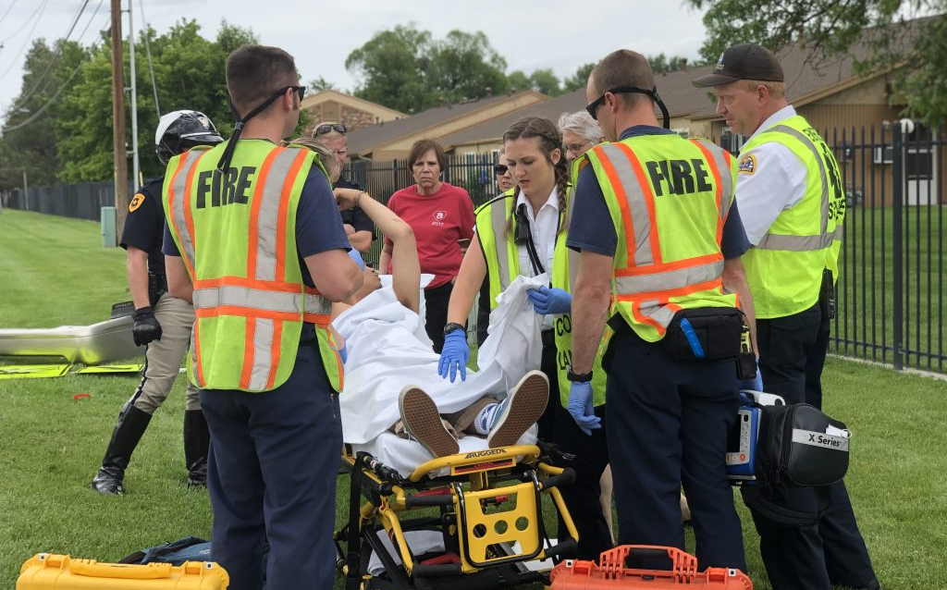
And firefighters help during medical emergencies. Do you know where firefighters stay when they are not helping?

Slide 7
Firefighters live in a fire station when they are not on call. SLC Fire Station 03 is in your neighborhood. Cpt Kauffmann and his crew serve the area. They live here in their home away from home during their tour of duty. We’d like to show you some of the station and the crew.

Slide 8
Cpt Kauffmann has served SLC Fire for over 20 years. He is a
B platoon captain. He leads a four-person crew at Station 3.

Slide 9
The crew lives and works at the station for 48 hours during their duty shift. Here is Cpt. Kauffmann, FF Seeley, FF Perkins, and FF LaMarr. Let’s look in station 3 where they live and serve.

Slide 10
The kitchen is the heart of the station.
Family Kitchen Table: crafted by firefighters, it is where firefighters gather to eat, debrief, plan their days and socialize.

Slide 11
The crew prepares and eats meals together while serving.

Slide 12
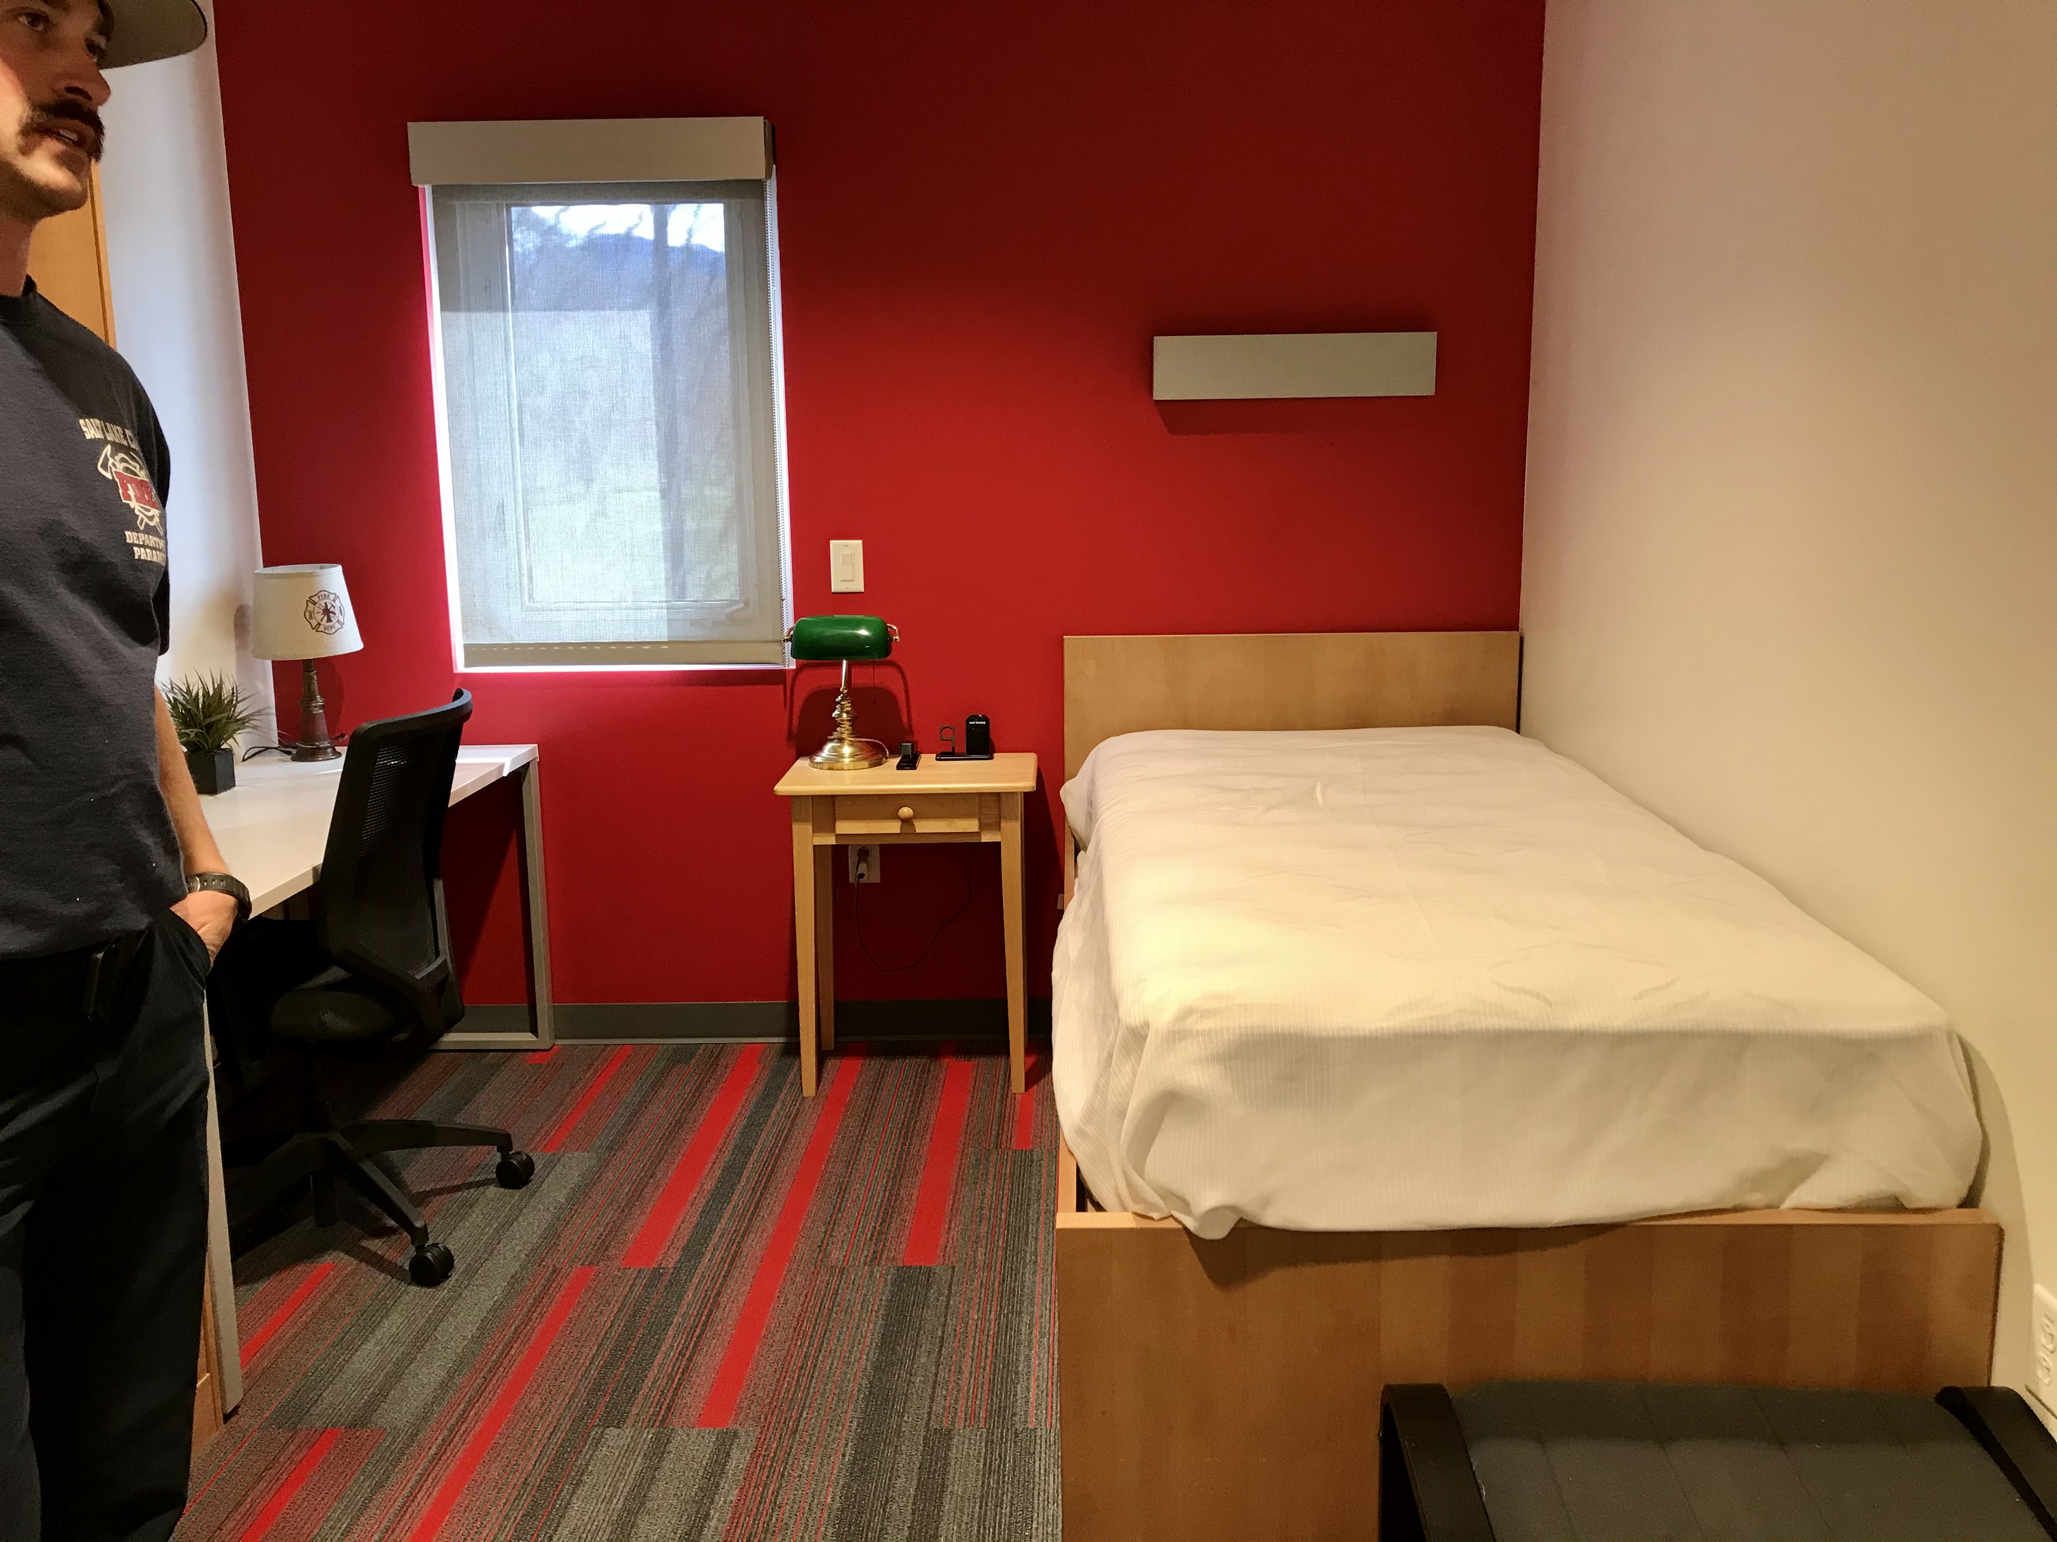
Firefighters have their own rooms at the station in which
they sleep for their 48-hour set.

Slide 13
They a sauna at the station to physically detox following fire response. This helps keep firefighters from getting sick.

Slide 14
The special gear they wear to fight fires is stored in a special room at the station. This gear can get polluted when used to fight fires, so we keep it separate from our living quarters.

Slide 15
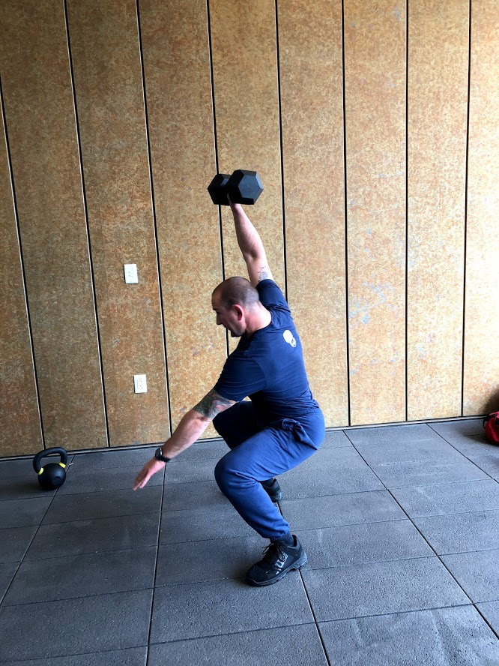
The crew works out to stay strong for the job.

Slide 16
Each station has a gym. This is the gym in Station 3.

Slide 17
Firefighters can take the pole or the stairs to quickly get to the engine when a call comes.

Slide 18
Firefighters clean their clothes and sheets in the laundry room at the station.

Slide 19
They relax on the patio. Every station has an outdoor cooker, a BBQ and smoker, for cooking meals. Firefighters eat well to maintain their energy for the job.

Slide 20
A large community room is available at the station for community meetings, social gatherings and training.

Slide 21
Cpt Kauffmann and the Station 3 crew are protecting your neighborhood every day of the year. We look forward to partnering with Nibley Park School this year to teach you some helpful fire and life safety lessons.

Slide 22
SLC Fire is Utah Capital’s Fire Service, and we are on call 24/7 living at the 14 stations through-out the city. Day or night, we will be there to help.

