Slide 1

500 East Resurfacing
May 13, 2020

Slide 2
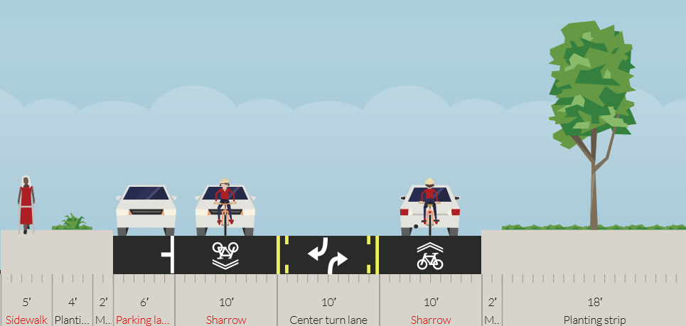
Existing Cross-Section

Slide 3
Survey Results
122 Responses
Major Takeaways:
  Lack of Bike Facilities
  Concerns about Speeding, Missing Sidewalks/Crosswalks
  Concerns about road surface conditions
  Concerns about lack of traffic control measures

Slide 4
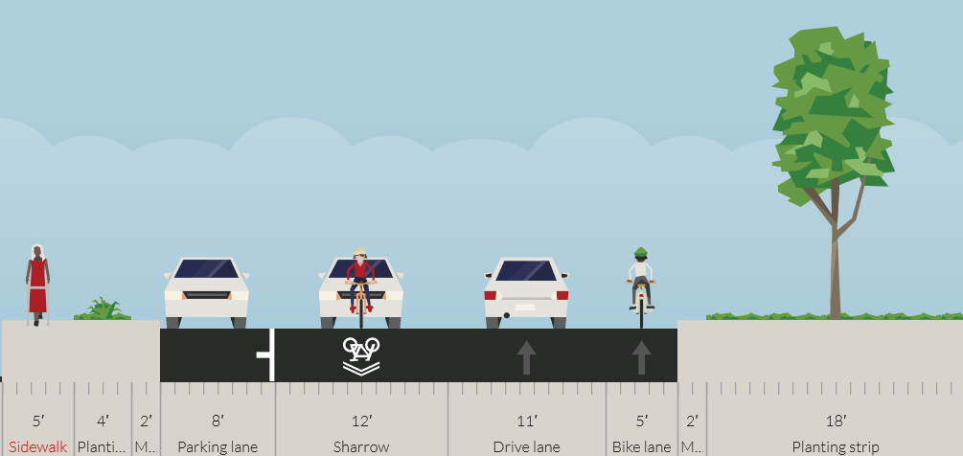
Initial Design Configuration
Notes:
Design Constraints Discussion about Bikes and FTN Route, Concerns about parking on East Side,

Slide 5
What We Heard Back
Concerns about lack of SB Bike Lane
Concerns about the 12’ lane and speeding
Concerns about pedestrian crossings and facilities

Slide 6
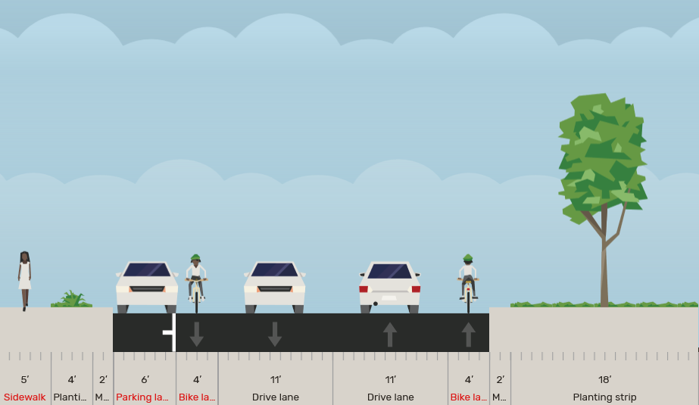
What SB Bike Lane would look like

Slide 7
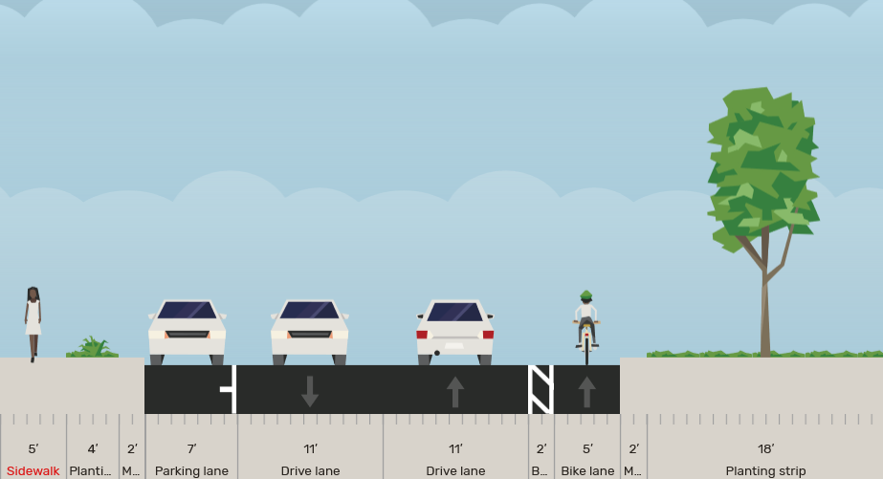
Updated Design Configuration

Slide 8
Next Steps
Interested in hearing this groups feedback on our updated design
Will be attending BAC next Monday to also receive feedback
Hoping to finalize this next week if possible based on that feedback
The resurfacing is now scheduled for the latter half of July (subject to change)
Continuing to receive comment at streetresurfacing@slcgov.com

