Slide 1
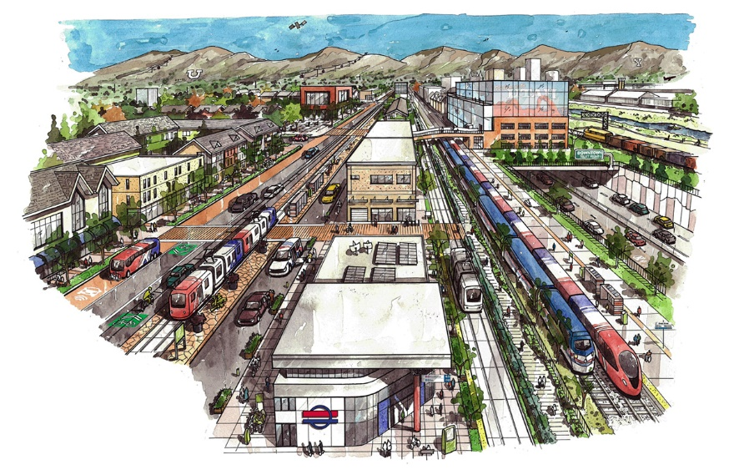
UTA Updates SLC BAC Meeting April 19, 2021

Slide 2
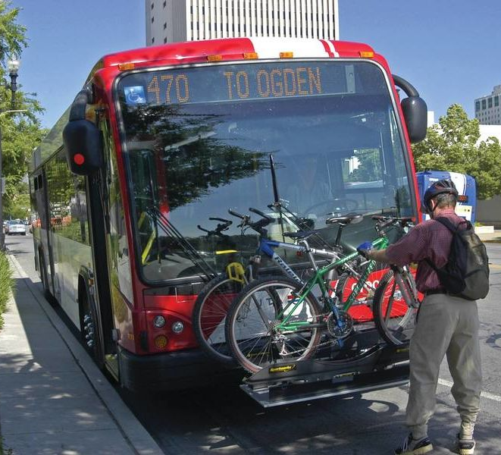
Agenda
New Planning Director Vacancy
UTA Long Range Transit Plan
Municipal Listening Tour
Active Transportation Master Plan

Slide 3
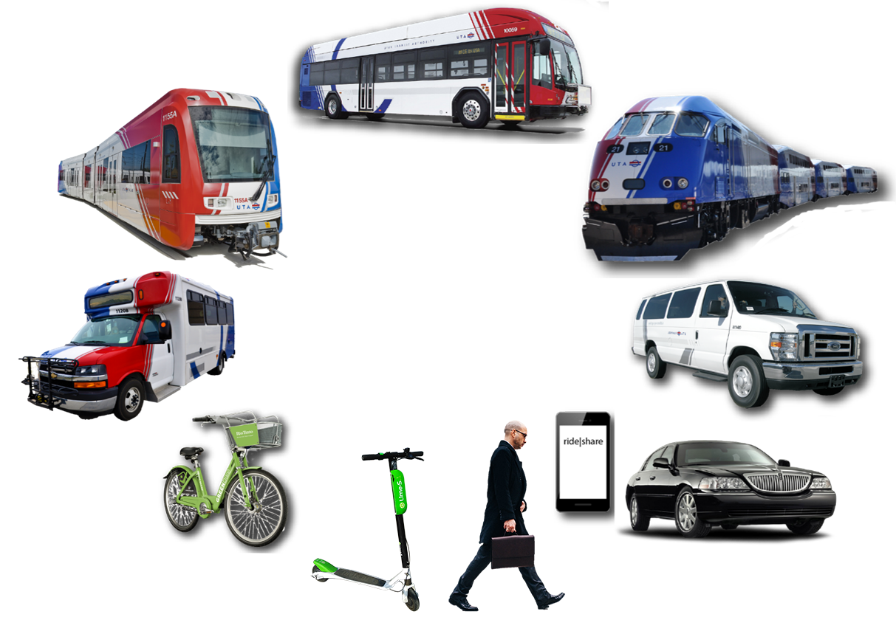
Long Range Transit Plan (LRTP)
We need your help to develop a cohesive, system-wide vision for public transit to best serve our communities’ needs, meet the demands of growth, and
attract additional resources
2019
104 days
Today
90 days
172 days
181 days
More information (soon):
https://rideuta.com/About-UTA/Active-Projects/Long-Range-Transit-Plan
Notes:
Purpose of LRTP to "understand and respond to future community needs" within UTA’s service area

Slide 4
LRTP Objectives
2019
104 days
Today
Strengthen partnerships with the communities
Assess long term transit needs
Develop system-wide future vision
Establish strategies for implementation
90 days
172 days
181 days

Slide 5
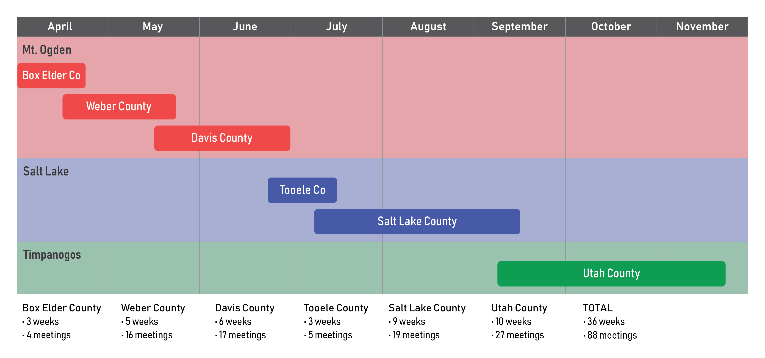
LRTP – Local Government Listening Tour
Meeting with 88 agencies across UTA service area to collect information on future land use and transportation changes
Notes:
Designed as a listening exercise – it will NOT focus on solutions for transit service. Interested in how municipalities are developing based on land use densities, employment nodes, and residential types, plus goals and priorities for transportation networks.

Slide 6
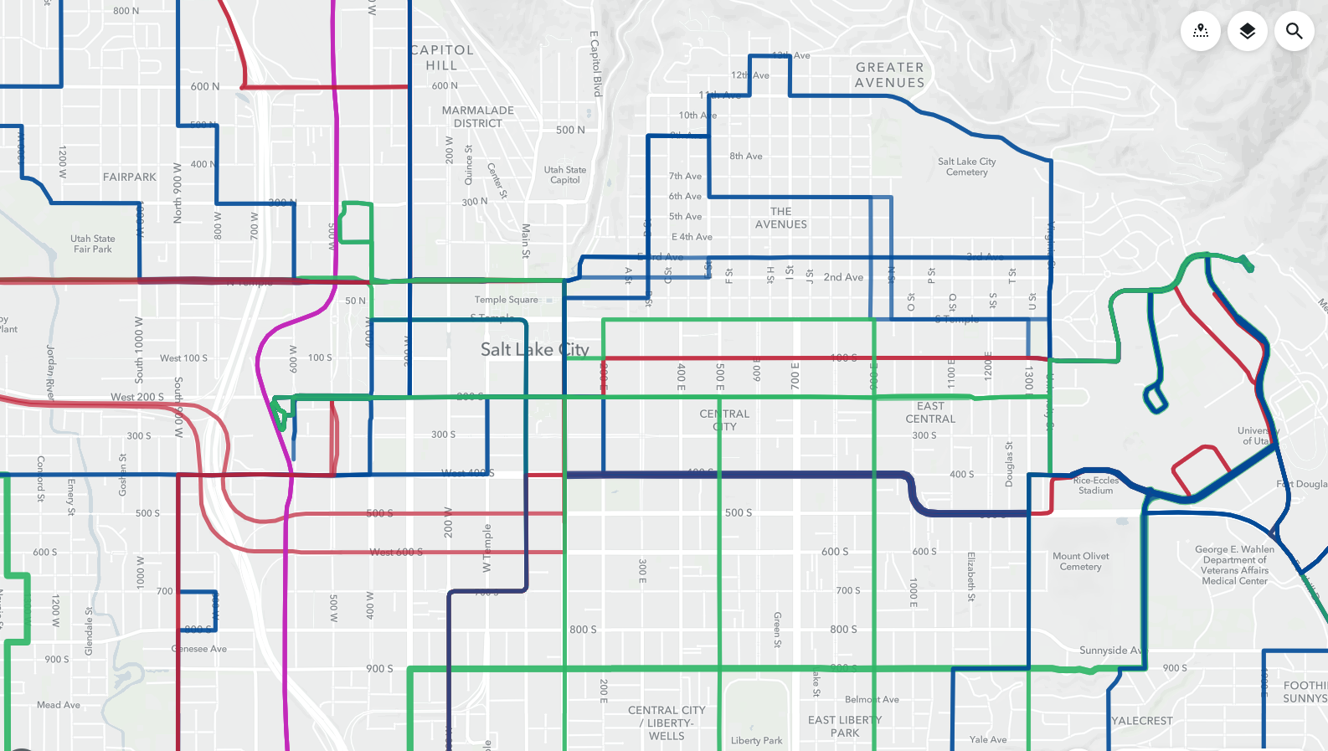
Active Transportation Master Plan
Measure AT access (0.5 mi for walking; 1.5 mi for biking) around bus stops and rail stations
Prioritize list of stops/stations based on improvement needs, investment, and level of use
Strengthen partnerships and coordination with external agencies to strategize access improvements
Identify opportunities for short- and long-term funding options to implement improvements
Notes:
Measurement will include GIS network analysis of AT infrastructure completeness, route directness and quality of facilities

Slide 7
Thank you! . Any Questions?
Please feel free to reach out to me anytime: kkinkead@rideuta.com

Slide 8
UTA Planning Process
The Regional Transportation Plans (RTP) include major capital projects, major transit needs but not local bus service.
The UTA Long Range Transit Plan (LRTP), is a complimentary process to the RTP, and will present a comprehensive, 30-year vision for public transit including local service and other transit related items not included in the RTPs.
UTA’s Five-Year Service Plan outlines a plan for implementation of short-term service improvements.
The Operational Planning process refines and finalizes annual service changes, which are then Implemented on Change Day.
Strategic Planning
(4-year cycle)
UTA
LRTP
WFRC & MAG
RTPs
Service Planning
(2-year cycle)
Five-Year
Service Plan
Annual Operations Planning
Operations Planning
(annual cycle)
Implementation
(3 times per year)
Change Day
Engagement opportunity

Slide 9
LRTP & RTP
UTA’s LRTP is complementary to, but different from the MPO’s RTP planning processes.
MPO RTP
UTA LRTP
UTA works closely with Metropolitan Planning Organization (MPO) partners, WFRC and MAG, in the development of Regional Transportation Plans (RTPs).
Although the LRTP will contain information beyond the scope of the RTPs, it will also help UTA prepare to collaborate with the MPOs on updates to the RTPs.
Regional Focus
All Transportation Modes
Capital Project Driven
4-Year Cycle
Community & Data Driven
30-Year Vision
Region & Local Focus
Emphasis on Public Transit
Projects, O&M, Support

Slide 10
Preliminary Timeline of Primary Tasks
Adoption of 2023-2050 LRTP
LRTP Process Kick Off!
4/21
3/23
Q2
Q3
Q4
Q1 2022
Q2
Q3
Q4
Q1 2023
2023
4/21
Municipal Listening Tour
11/21
4/21
Data Collection & Analysis
11/21
2021
Preliminary Goals Development
11/21
2/22
Today
Phase I Community Engagement
221 days
1/22
4/22
221 days
4/22
Draft Scenarios & Plan
8/22
103 days
Phase II Community Engagement
8/22
10/22
90 days
10/22
Finalize Scenarios & Plan
2/23
120 days
90 days
120 days
Notes:
Major Tasks
Listening Tour + Data Collection & Analysis.
Preliminary Goals Development
Public Engagement
Draft Scenarios and Plan
Finalize Scenarios and Plan

